Slide 1
Cloud-native Cross-team SDLC automation PoC
A very simple demonstration
Somnath Mukherjee, 2025

Slide 2
That implements:
Cross-team ops using modern SDLC automation
Full team autonomy
Single responsibility across teams
Centralised code governance & compliance
Centralised proactive threat mitigation measures
GitOps style

Slide 3





Example scenario:
Gus Fring wants to build a Breaking Bad style order fulfilment system using cloud-native SDLC automation with several teams
A Typical Online Food Ordering system

Slide 4
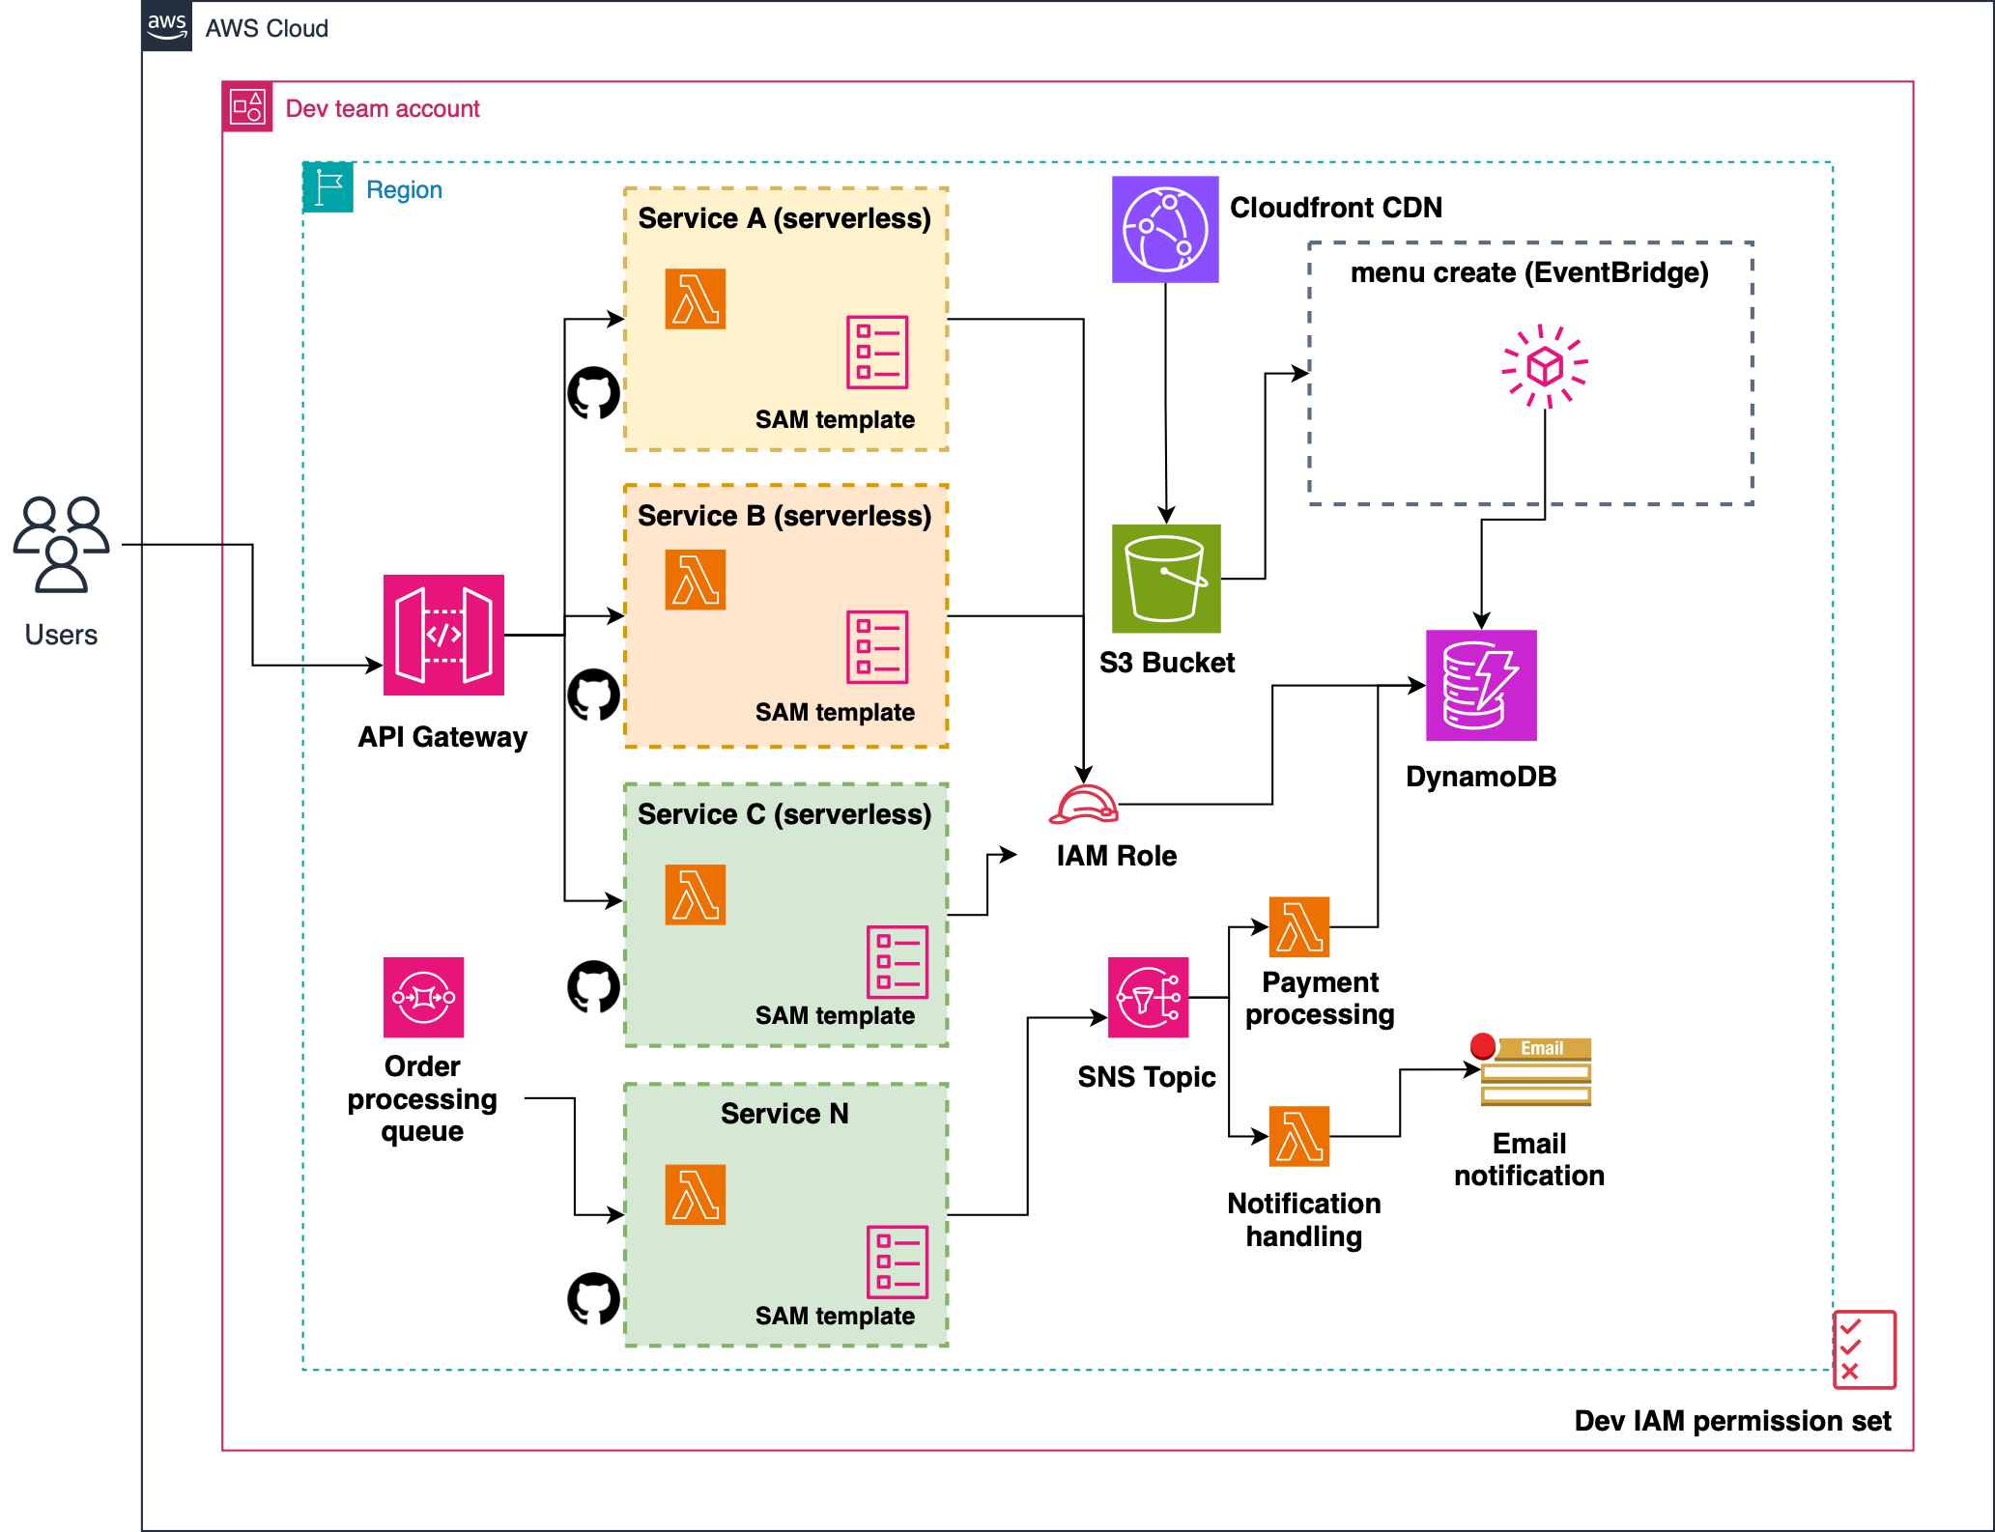
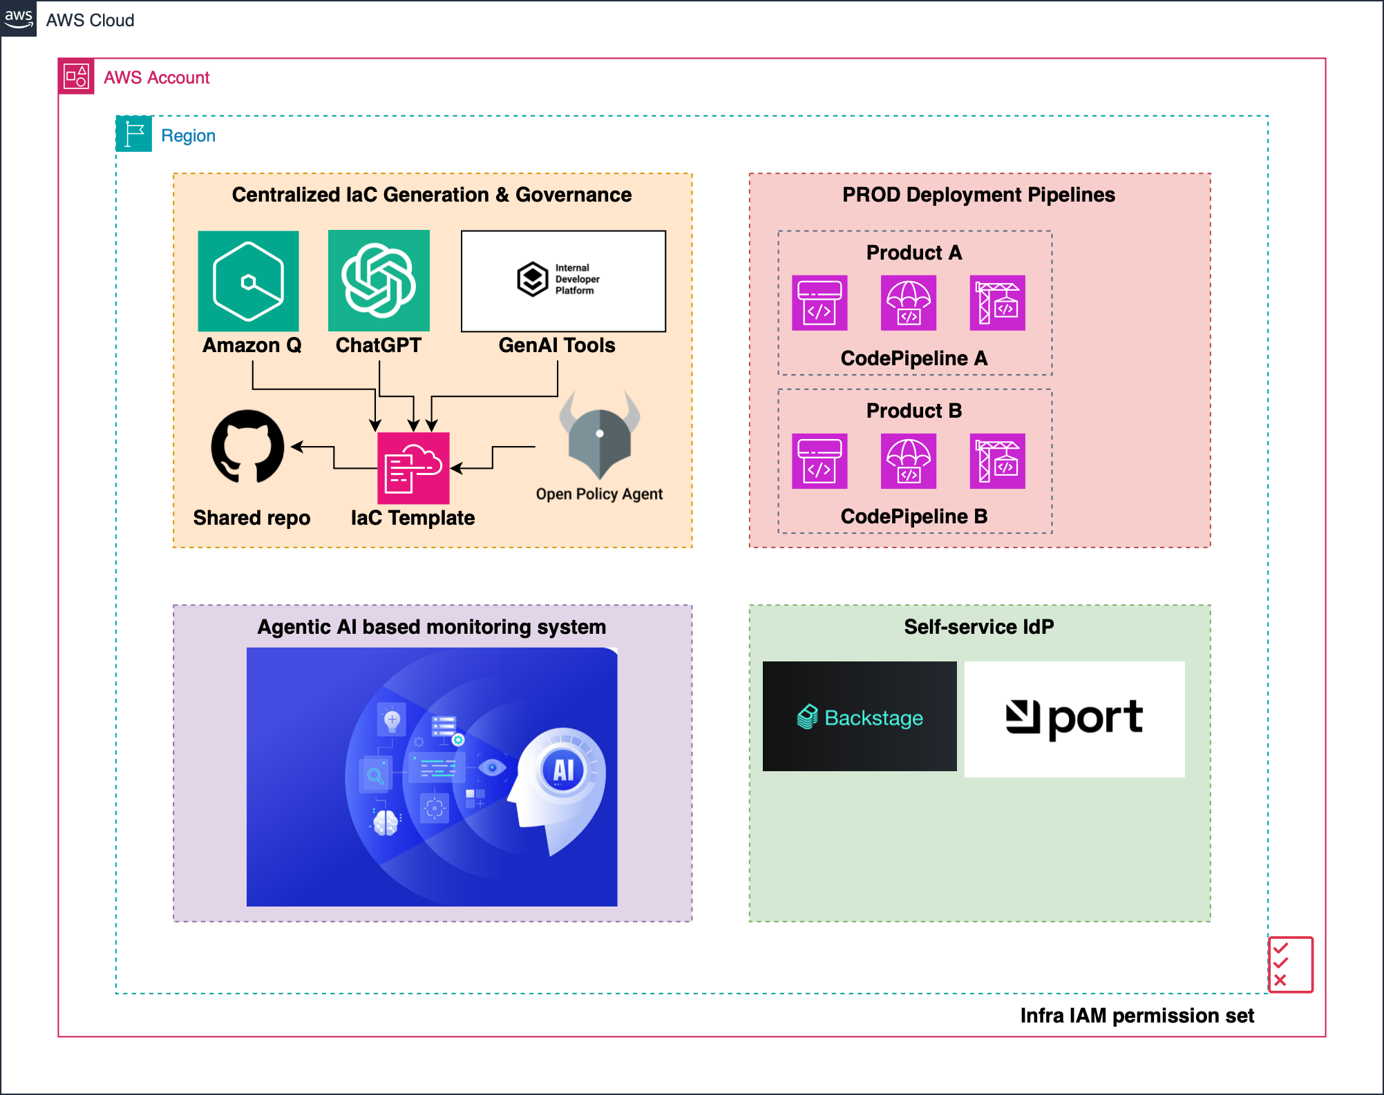
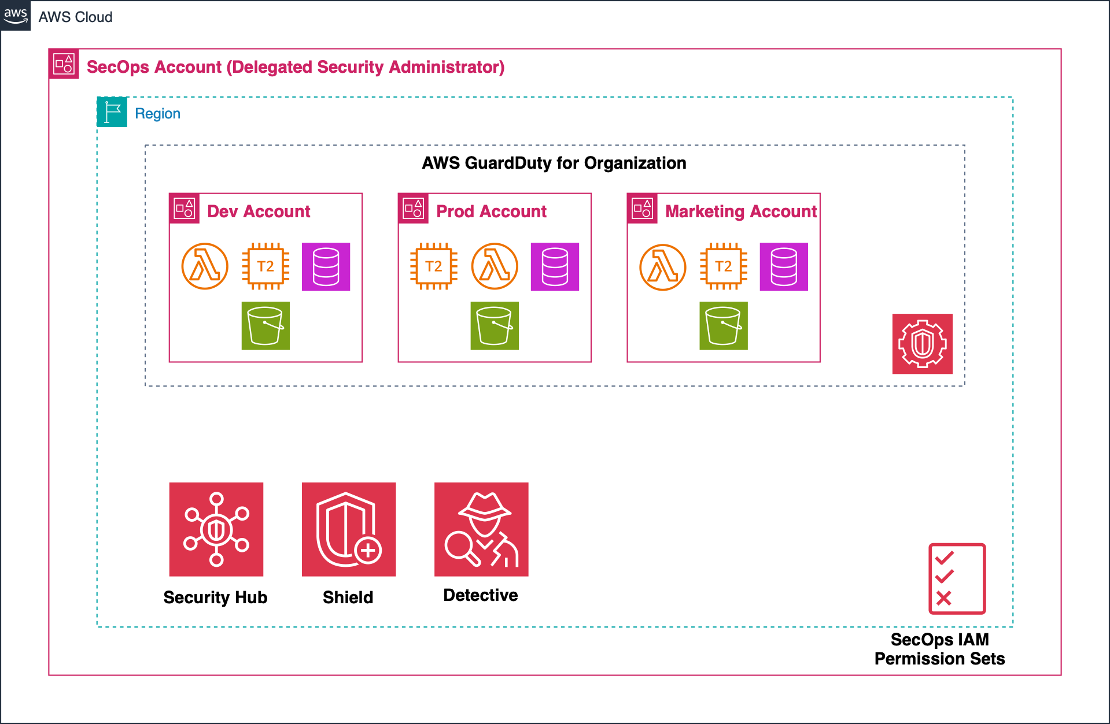
SecOps team
Dev team
Infra / Platform team

Slide 5
Dev team
Scales to thousands of microservices, per repo
Each service supports environment promotion with manual approval (Dev -> Test -> Staging -> Prod)
Each service with independent pipelines using pipelines-as-code templates
Idempotent service deployment using IaC templates collaborated by Infra team
Full autonomy: Developers have freedom to build & deploy upto a certain point
Least privilege principle: only granted permissions that are required, using IAM Permission Sets

Slide 6
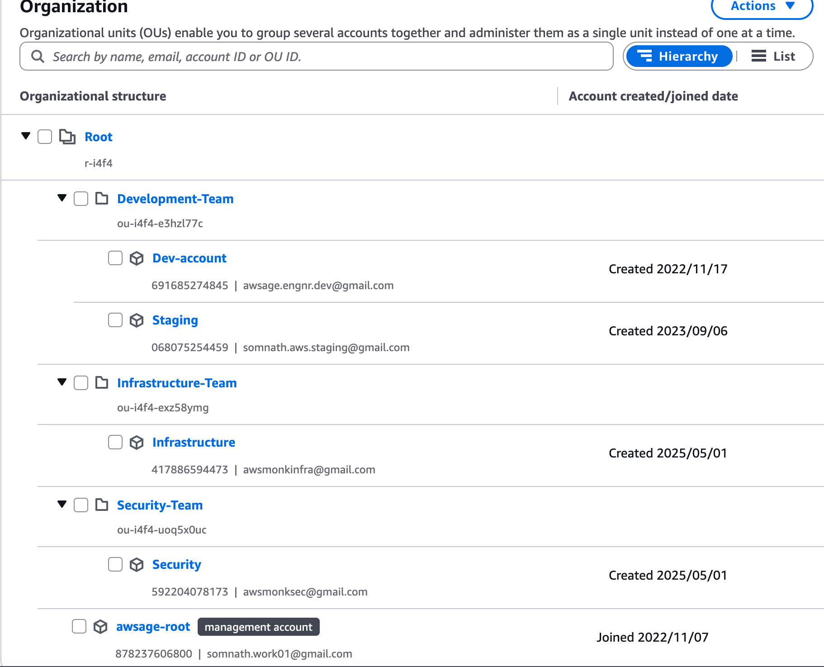
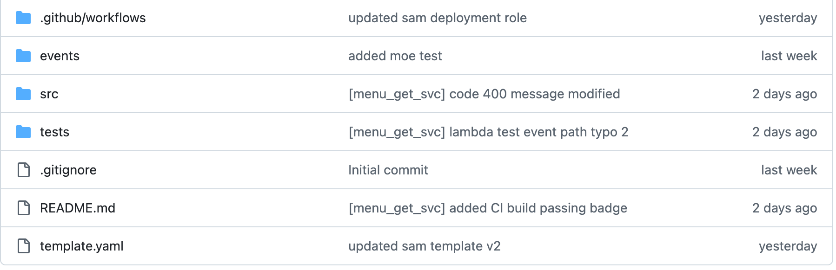
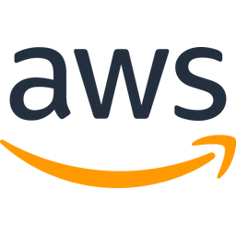

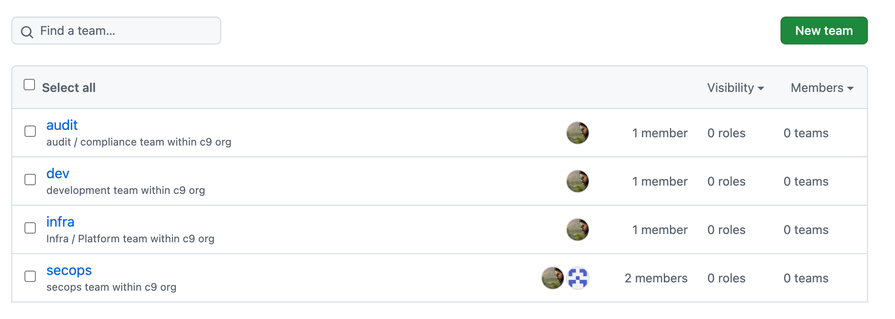
Org & repo
structure
Team setup in AWS
A Sample microservice (python)
Service A
Service C
Service B
Service N
Team setup in GitHub

Slide 7
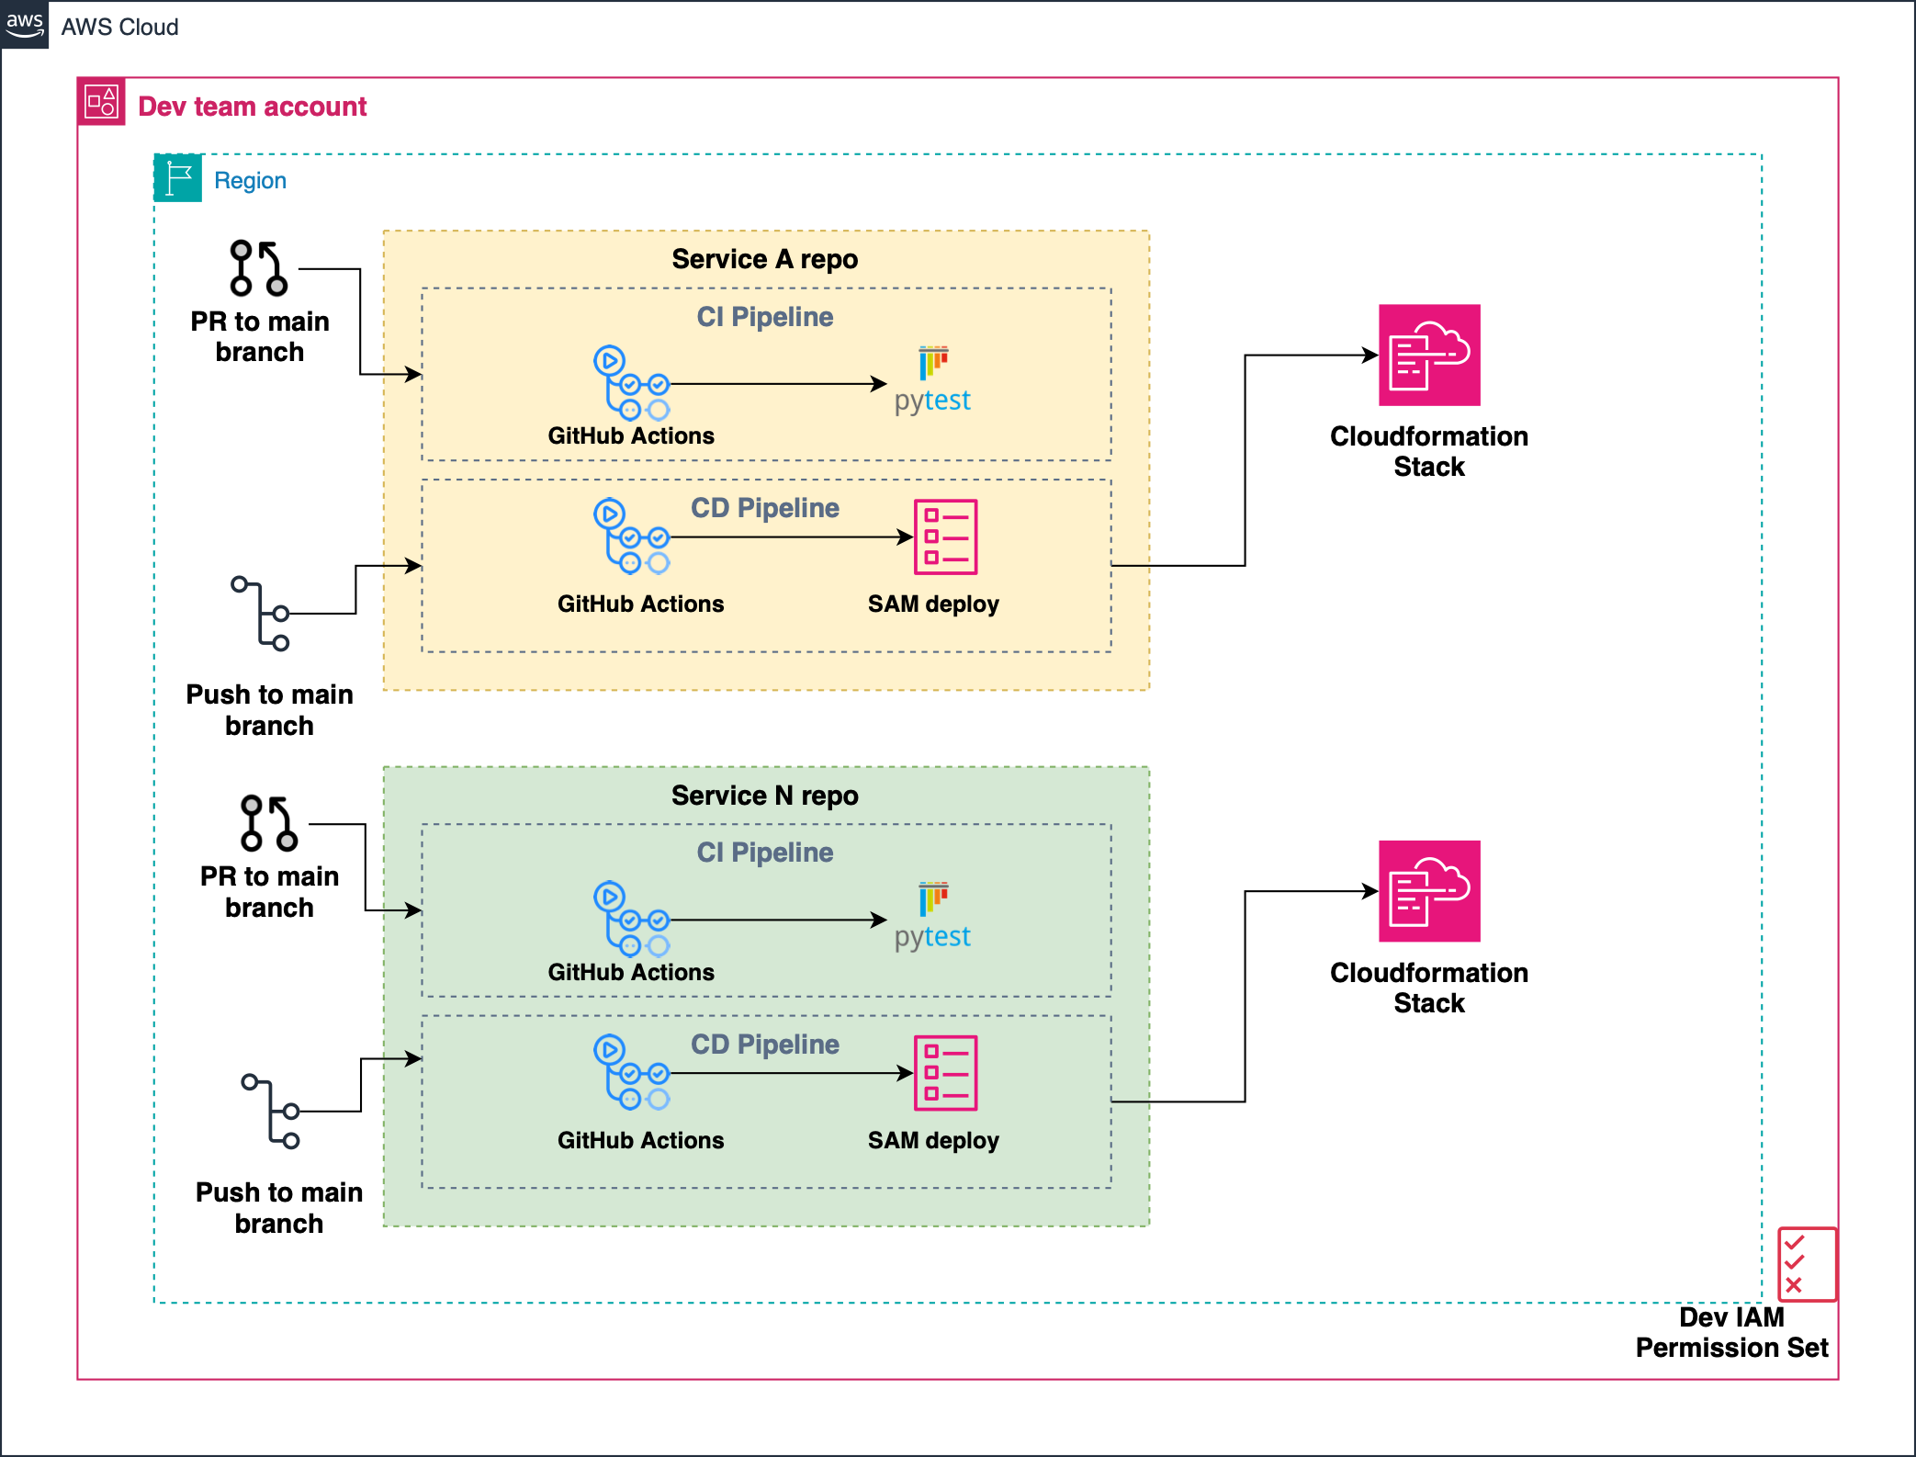
Dev team’s pipeline
Dev team fully owns a service’s creation, development & deployment lifecycle
Dev team can self-service it’s operation through a portal
Each service is a repo to minimise deployment friction
GitOps is the source of truth
Deployment is made with IaC templates written by Infra team

Slide 8
Infra team
Easier service deployment using standard IaC templates, generated by GenAI (e.g. ChatGPT)
Generated IaC templates are validated using Policy-as-Code tools such as Checkov or OPA before deployment. This enforces compliance & governance
Privileged access: to Prod environment pipelines
Provides a self-service IdP portal for all teams to quickly do things without repetition
Implements an Agentic AI based monitoring system that learns workloads and it’s deployment pattern to optimise cost

Slide 9
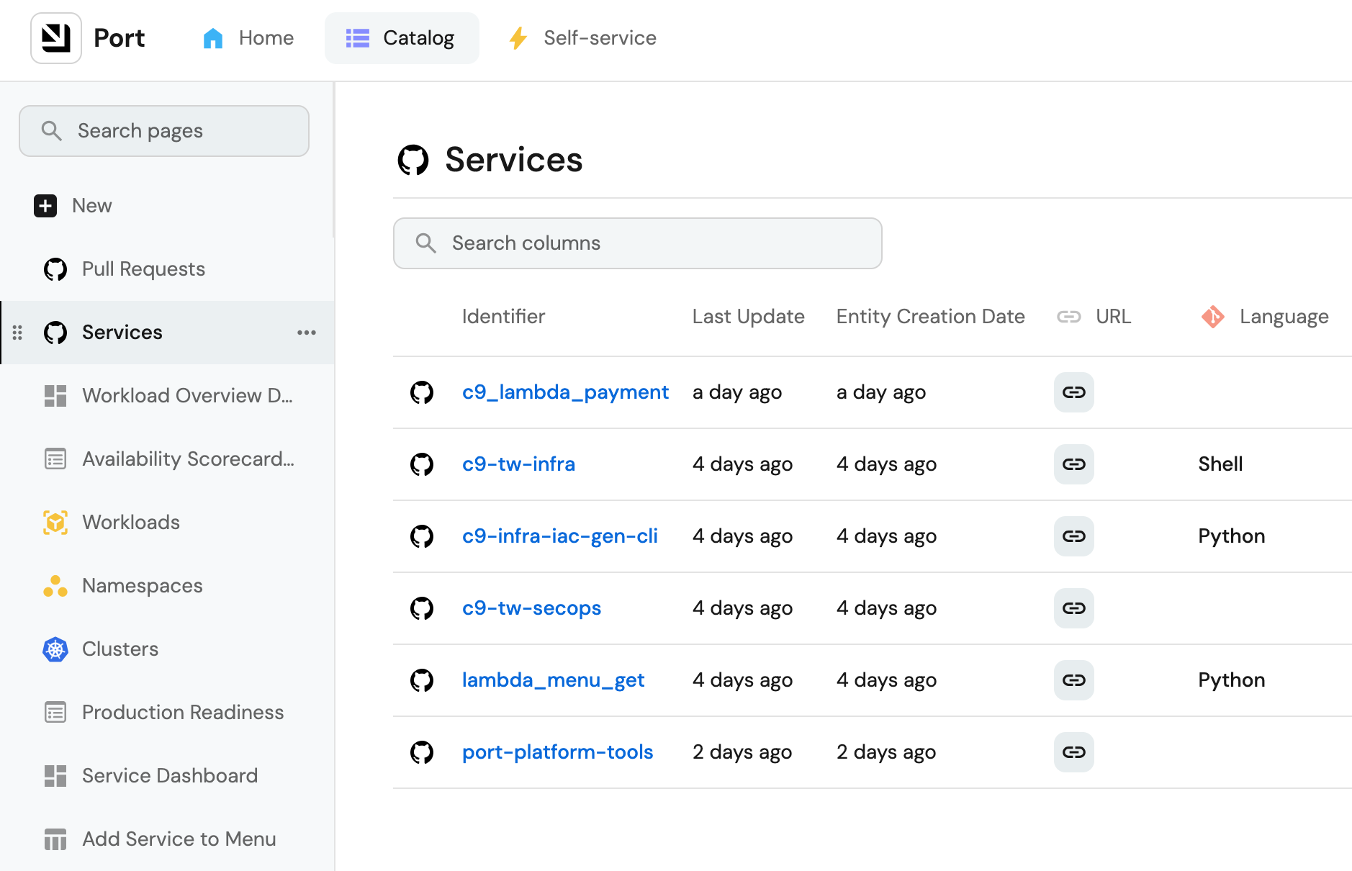
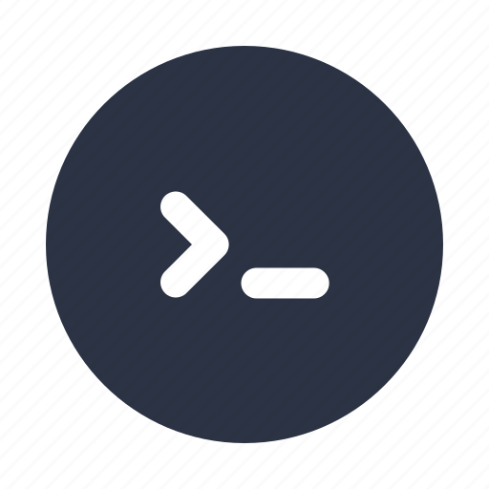
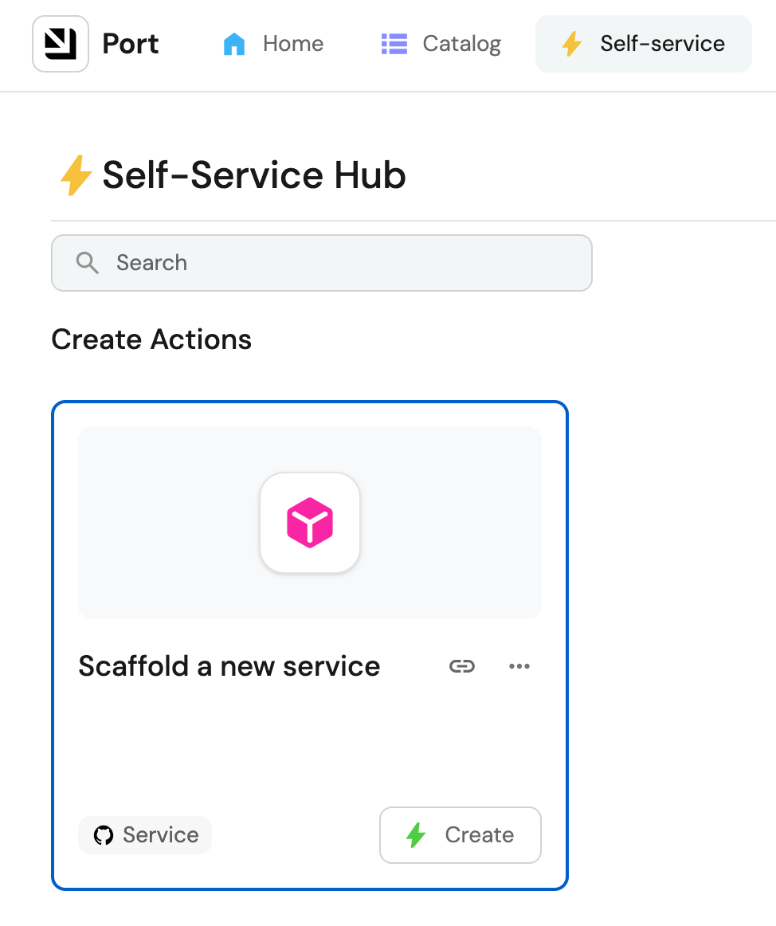
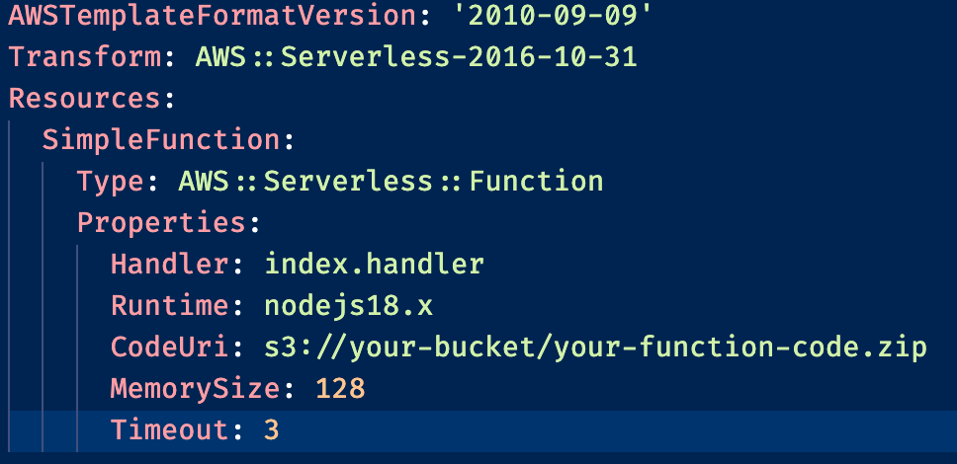
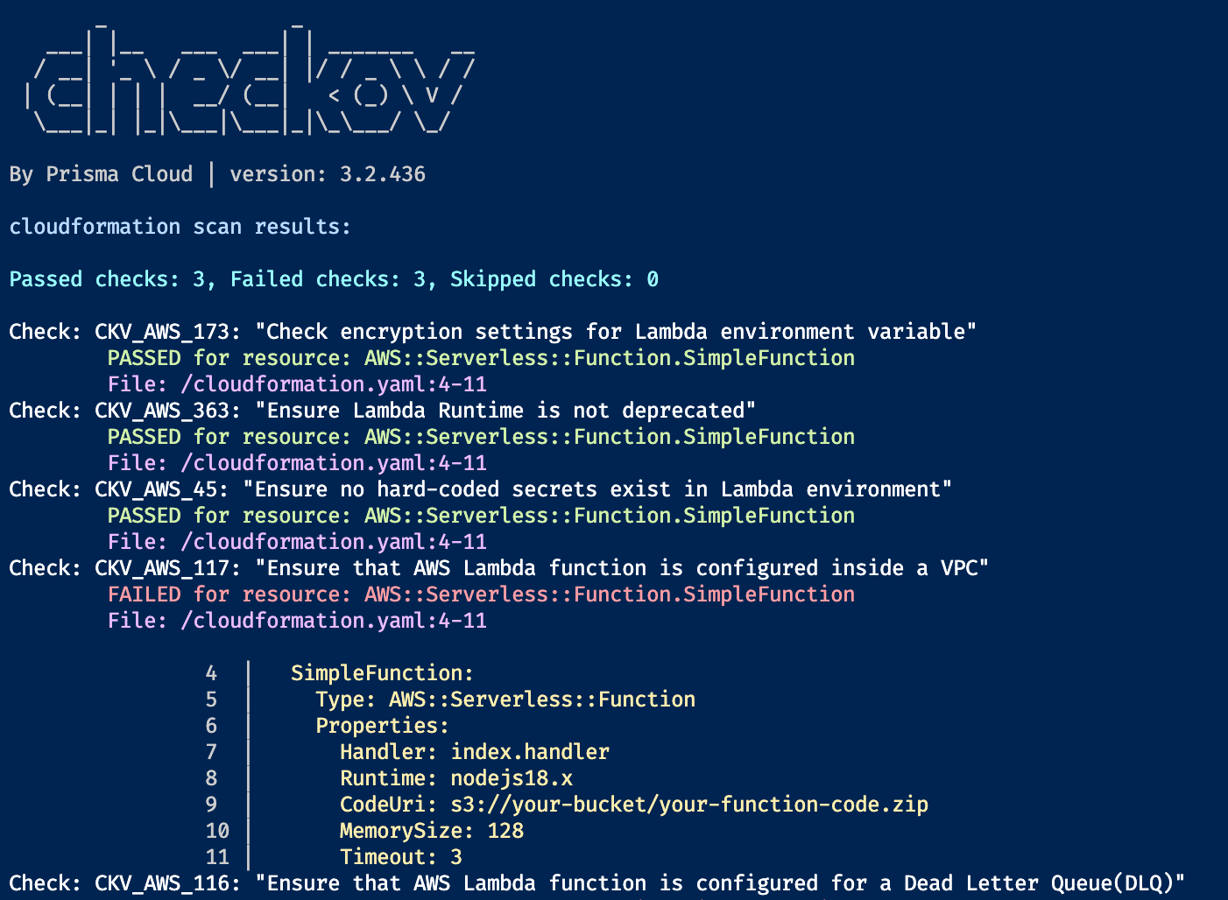
Infra team’s resource
A CLI tool to generate IaC template using ChatGPT like prompts
A Internal Developer Portal (IdP) using Port to self-service all team’s servicing needs
Generated SAM template
Policy as code checking

Slide 10
SecOps team
Acts as a delegated security administrator across Org
Centrally scans all team’s resources for potential vulnerabilities & threats
Generate & share GuardDuty findings across teams
Implement additional proactive ITSIEM tools

Slide 11
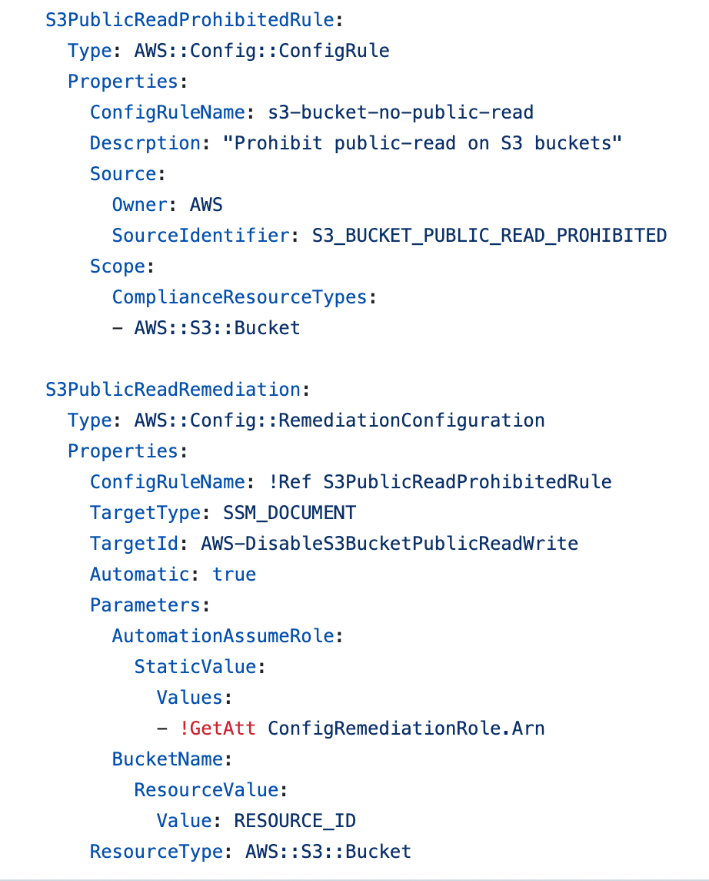
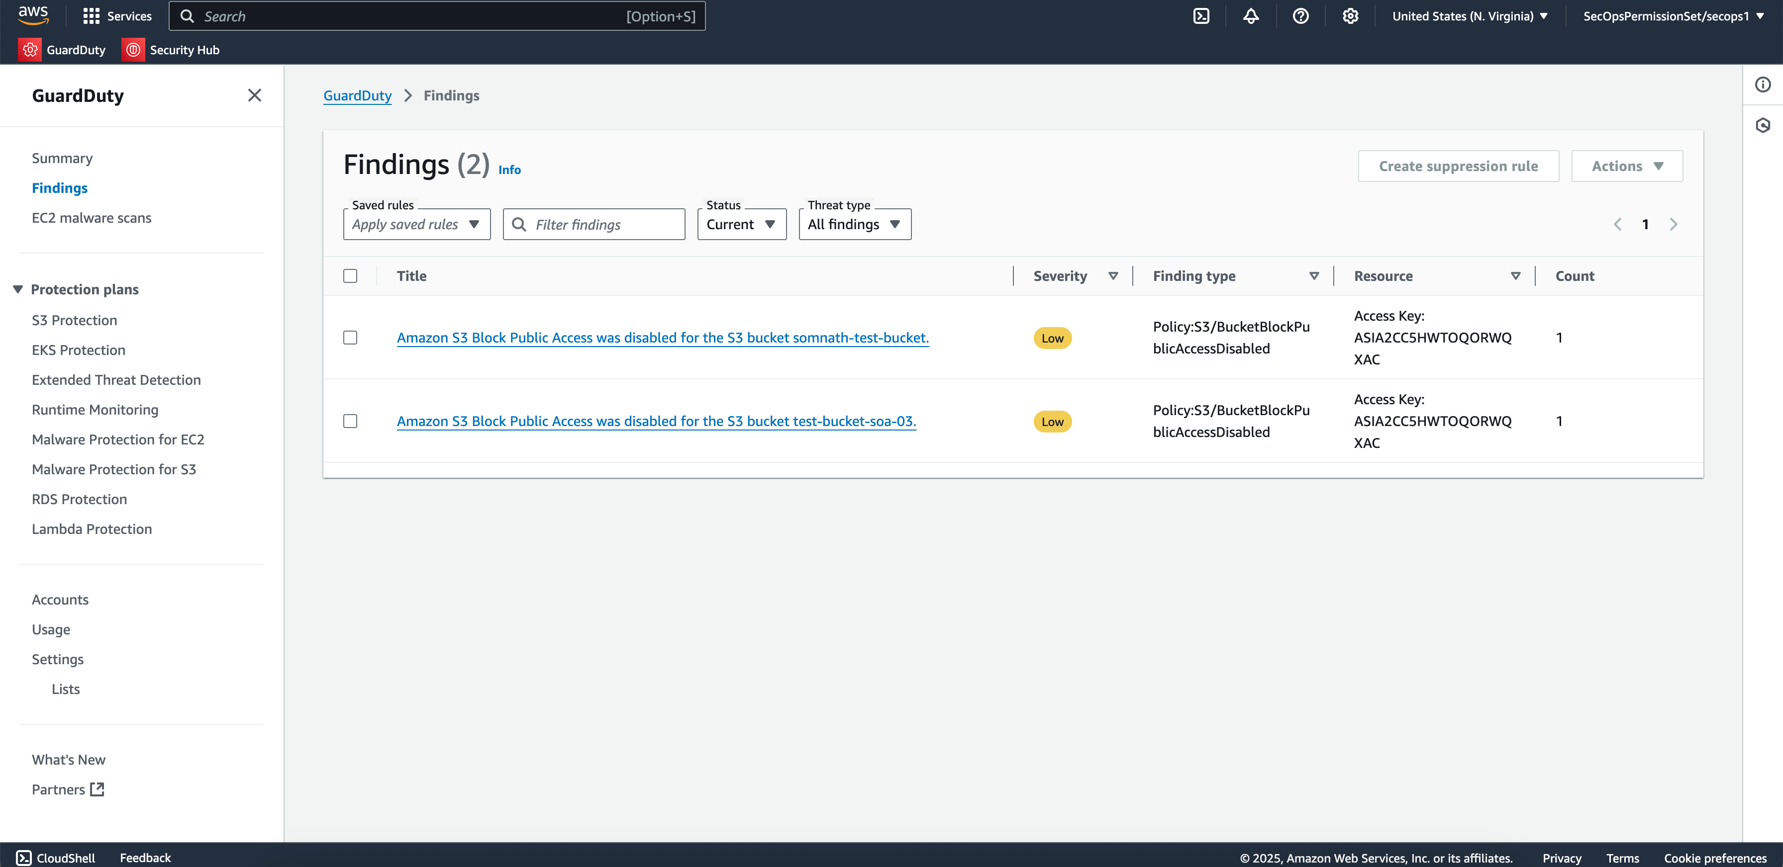
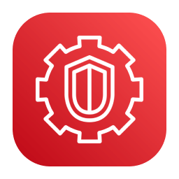
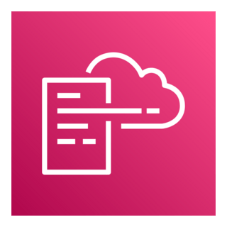
SecOps team’s
findings & remedies
Amazon GuardDuty findings
Amazon SSM auto-remediation

Slide 12
Thank you

